Slide 1
Danfoss-Mini TT Shaft Bearing Press
Team 512
February 1, 2024

Slide 2

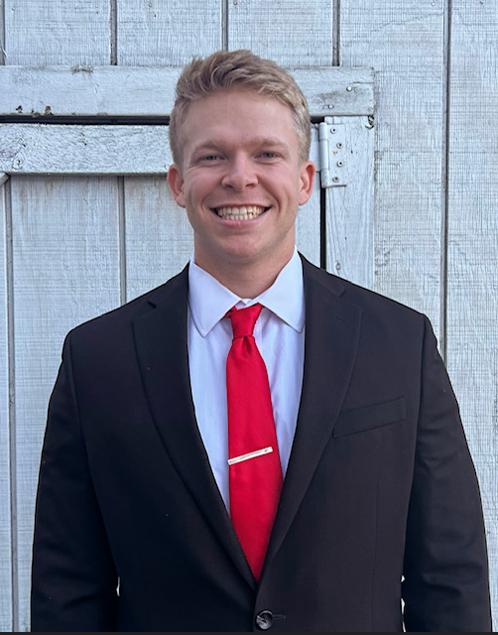
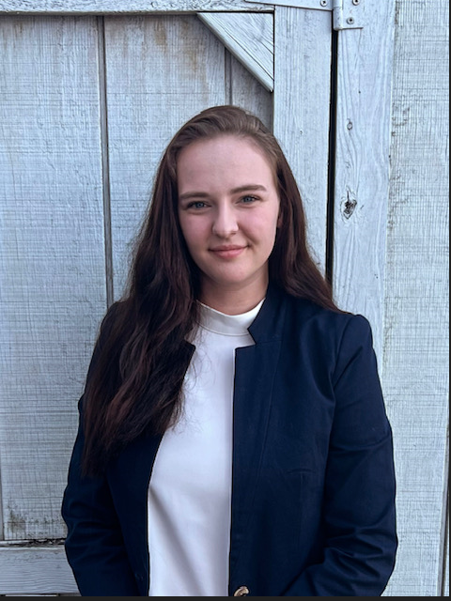
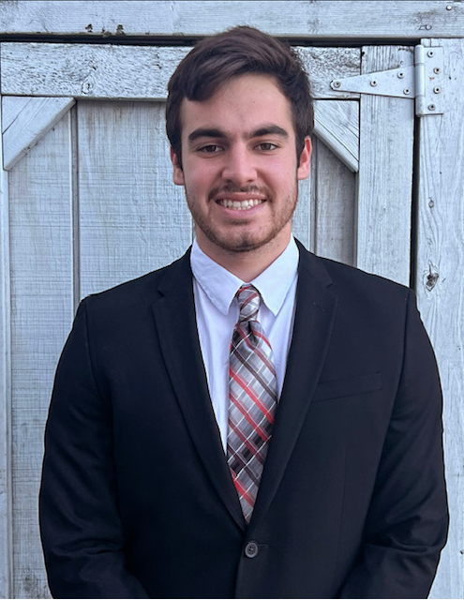
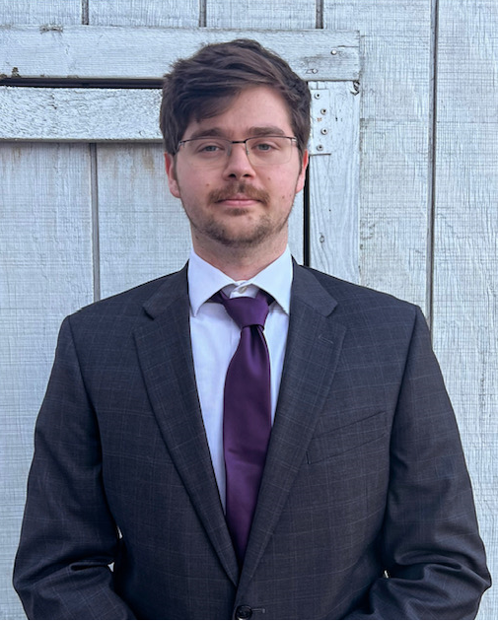
Team Introductions
Clark Cooley
Systems Engineer
Cassie Bentley
Fluids Engineer
Colby Gullo
Safety Engineer
Brent Mynard
CAD Engineer

Slide 3

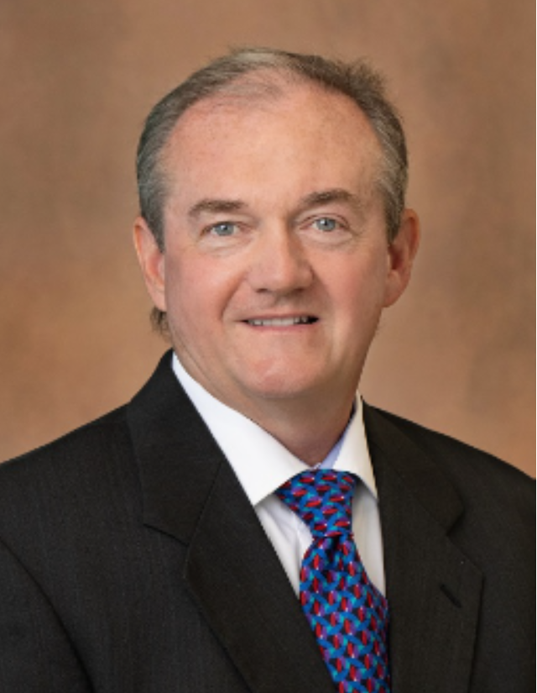
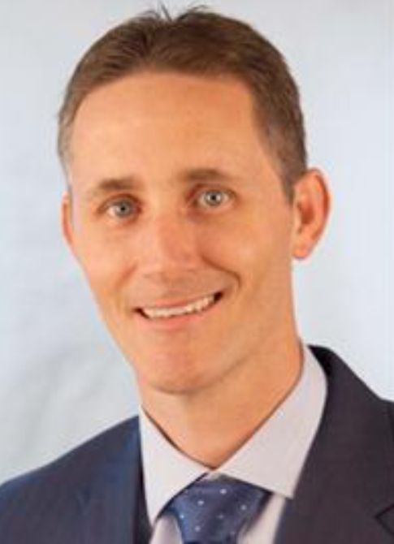
Sponsor and Advisor
Engineering Mentor
Kevin Lohman
Sponsor
Engineering Mentor
William Bilbow
Point of Contact & Sponsor
Academic Advisor
Shayne McConomy
Professor

Slide 4
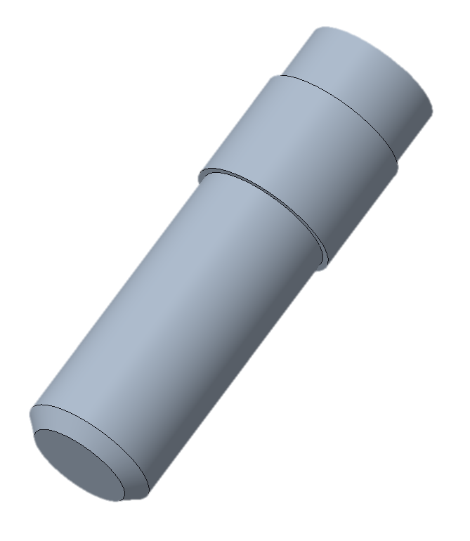
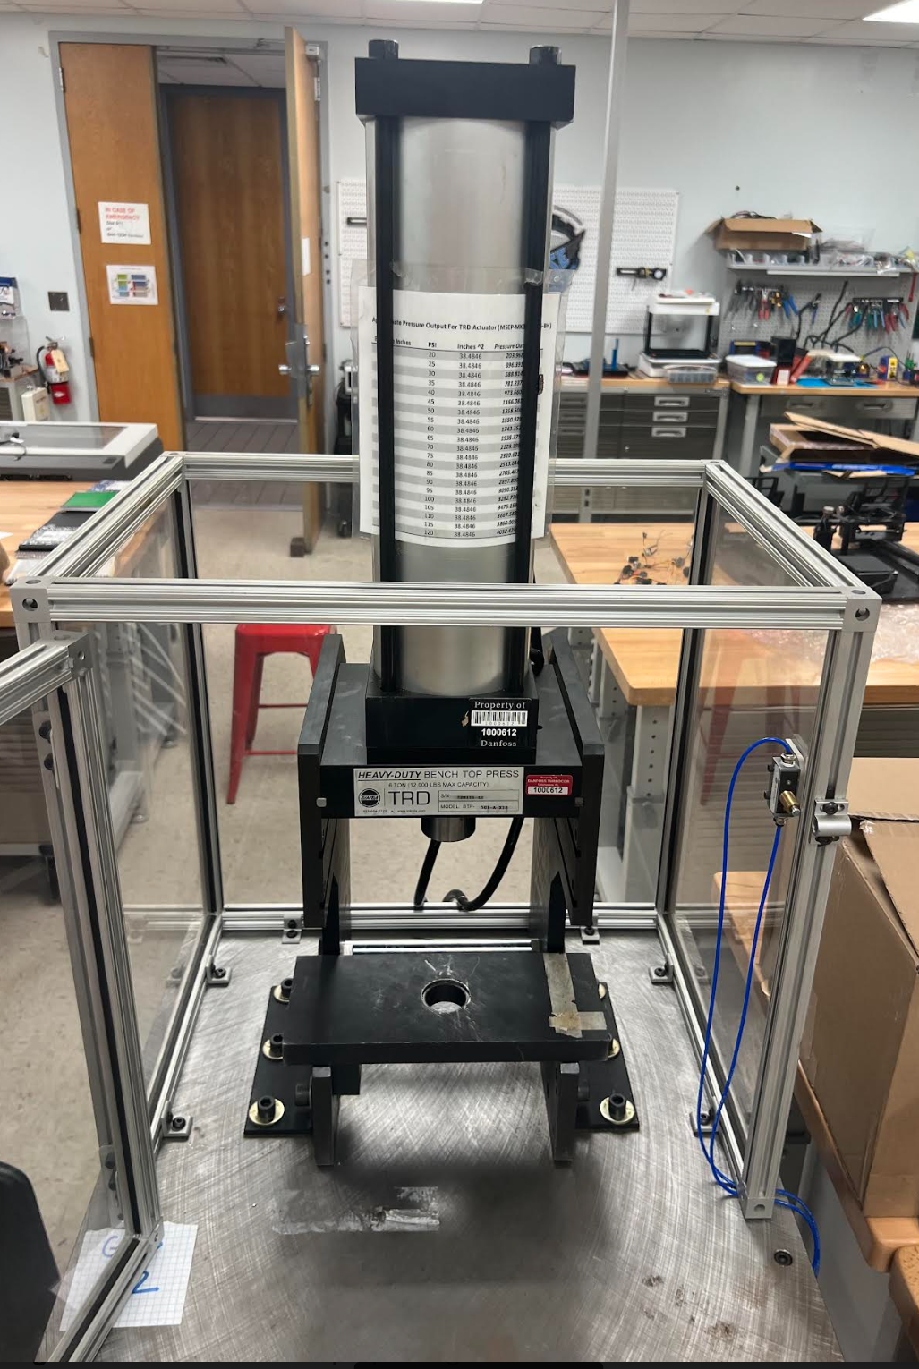
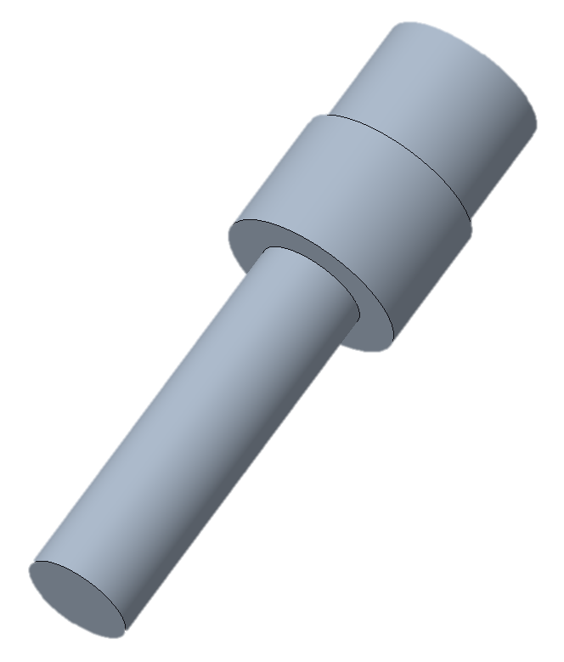
Our Project:
Previous Shaft
Updated Shaft

Slide 5
Last Semester: Achievements
Sponsor Wants
Press to be manufactured in the US
C-Frame
Pneumatic
More Pressure

Slide 6

Last Semester: Recap
Sponsor Wants
Press to be manufactured in the US
C-Frame
Pneumatic
More Pressure
Problems
7 manufacturers in the US
H-frames are more common
Making the press pneumatic means less pressure
Price increases significantly

Slide 7
Last Semester: Recap
Problems
7 manufacturers in the US
H-frames are more common
Making the press pneumatic means less pressure
Price increases significantly
Solution
Create a Matrix of Requirement Chart to show the difference in cost, manufacturers, pressure, and power.

Slide 8
Last Semester: Recap
Solution
Create a Matrix of Requirement Chart to show the difference in cost, manufacturers, pressure, and power.

Slide 9
Last Semester: Recap
Solution
Create a Matrix of Requirement Chart to show the difference in cost, manufacturers, pressure, and power.

Slide 10
Last Semester: Recap
Sponsor Wants
Press to be manufactured in the US
C-Frame
Pneumatic
More Pressure

Slide 11
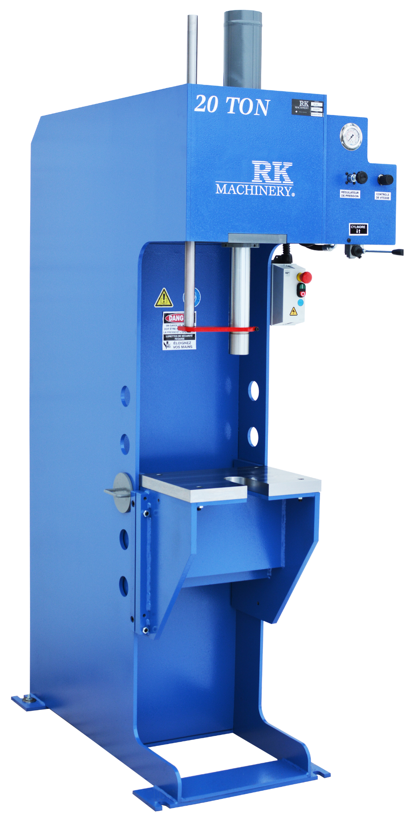
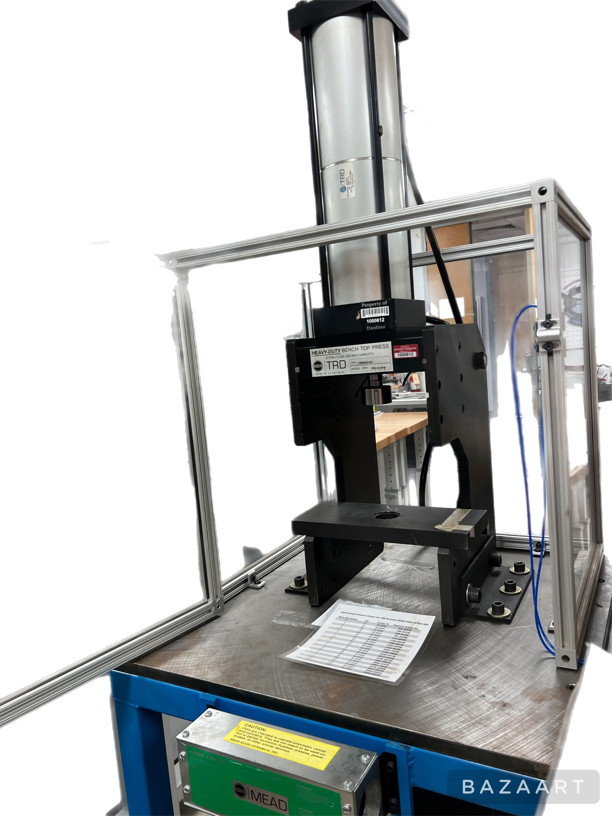

Last Semester: Recap
Sponsor Wants
Press to be manufactured in the US
C-Frame
Pneumatic
More Pressure

Slide 12
Last Semester: Recap
Sponsor Wants
Press to be manufactured in the US
C-Frame
Pneumatic
More Pressure

Slide 13
Last Semester: Recap
Sponsor Wants
Press to be manufactured in the US
C-Frame
Pneumatic
More Pressure

Slide 14
Last Semester: Recap
Sponsor Wants
Press to be manufactured in the US
C-Frame
Pneumatic
More Pressure

Slide 15


Last Semester: Achievements
Adapting To Unexpected Challenges

Slide 16

Last Semester: Achievements
Adapting To Unexpected Challenges
Feasibility

Slide 17

Last Semester: Achievements
Adapting To Unexpected Challenges
Feasibility
Problem Solving

Slide 18

Last Semester: Achievements
Adapting To Unexpected Challenges
Feasibility
Problem Solving
Importance of Clear Communication

Slide 19

Last Semester: Achievements
Adapting To Unexpected Challenges
Feasibility
Problem Solving
Importance of Clear Communication
Collaboration

Slide 20


Current Semester: Challenges
Budget Constraints
Make The Existing Press Work
Back To The Drawing Board

Slide 21
Current Semester: Challenges
Updated Sponsor Wants
Use Existing Press
Functionality
Safety

Slide 22
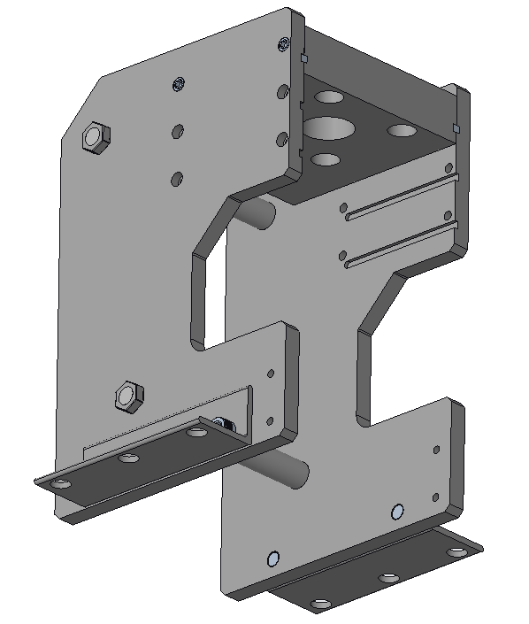
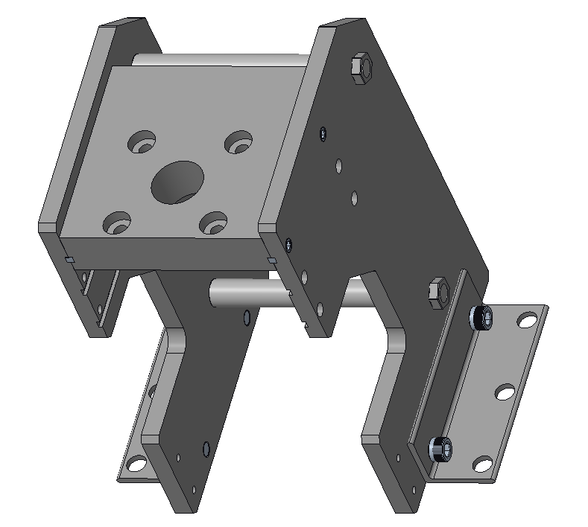
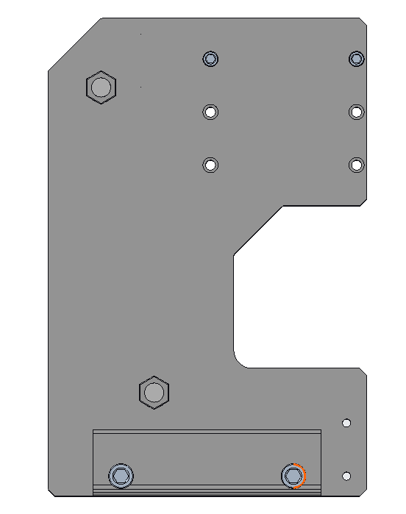
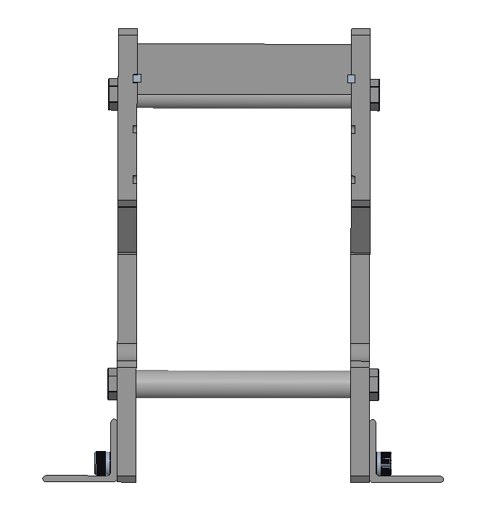
Current Semester: Milestone Updates
Old Press Design

Slide 23

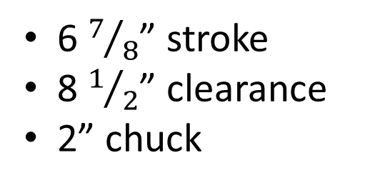
Old Design
6 $7/8$” stroke
8 $1/2$” clearance
2” chuck

Slide 24
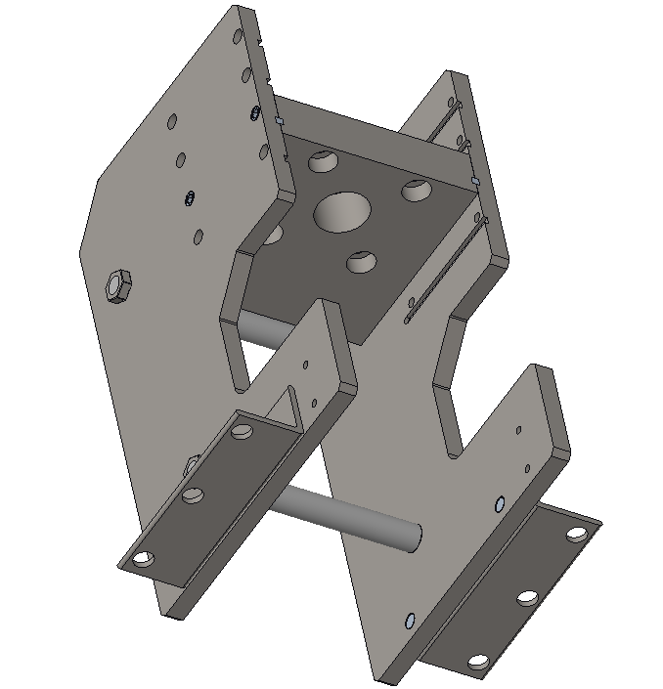
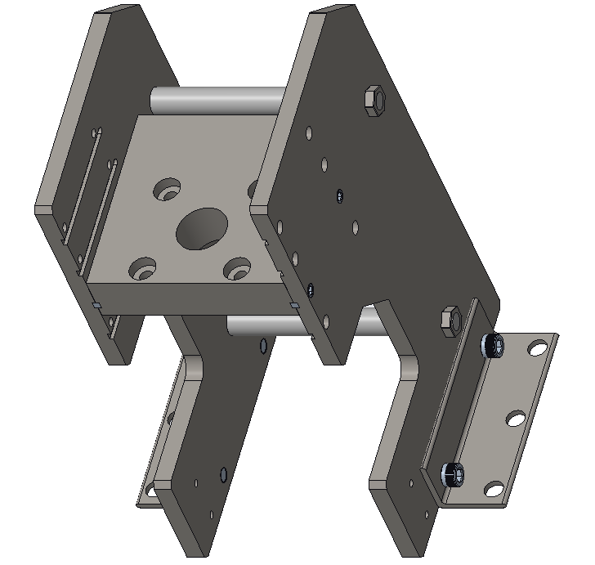
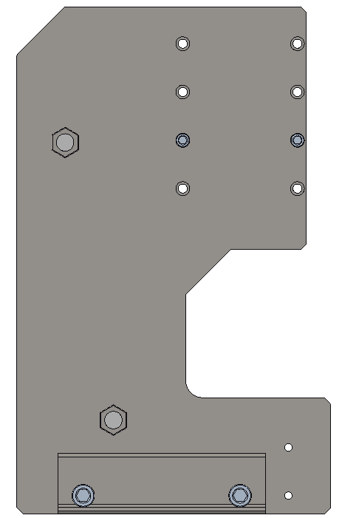
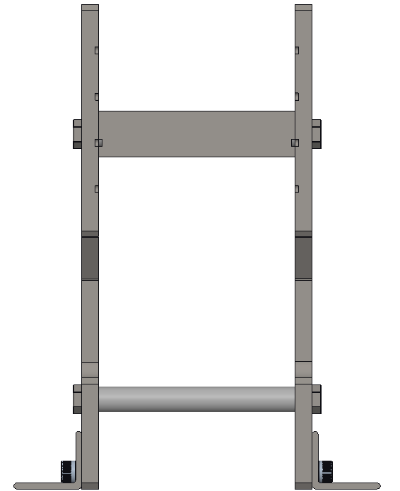
Current Semester: Milestone Updates
New Press Design

Slide 25
Current Semester: Milestone Updates
New Press Design

Slide 26


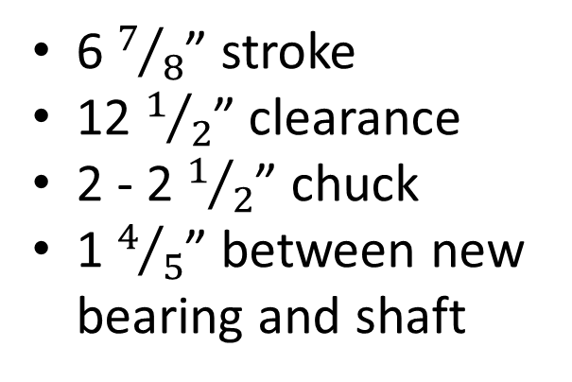
New Design
6 $7/8$” stroke
12 $1/2$” clearance
2 - 2 $1/2$” chuck
1 $4/5$” between new bearing and shaft

Slide 27
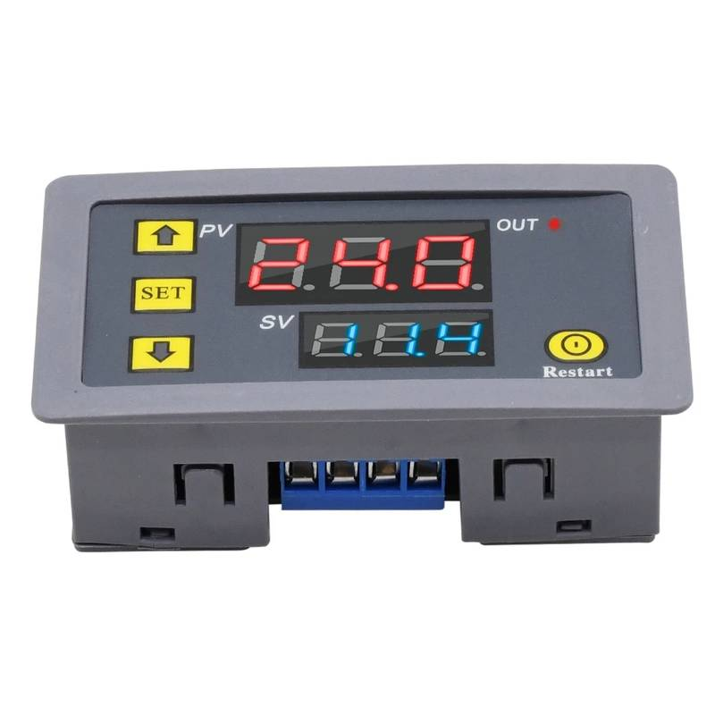
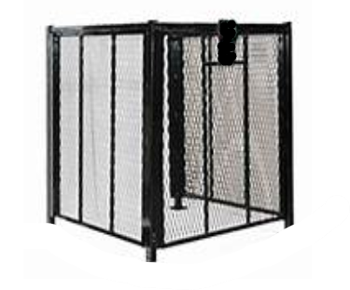
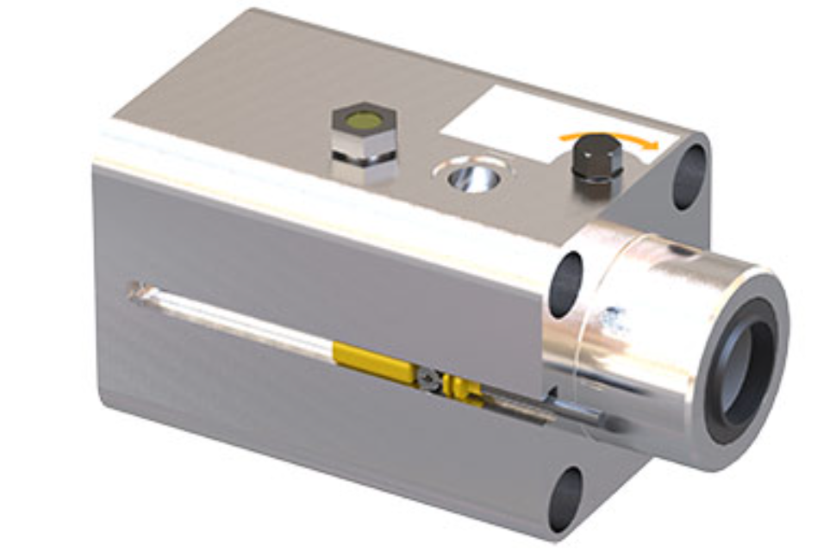
New Features
Keeping The Press Pneumatic

Slide 28
Collaborative Efforts
Keep The Press Pneumatic
Dr. Ordoñez
Cage
Danfoss Fabricator
Danfoss Machine Shop
The Frame Of The Press
Dr. Hollis
Oluwafemi Ogunlana
Vinayak Angadi

Slide 29



Navigating Challenges
Time
Money
Approval

Slide 30



Key Learnings
Plan A, B, C
Sponsor Needs
Setbacks

Slide 31



Future Plans
Finalize Design
Sponsor Approval
Metal Fabrication

Slide 32


Thank you

Slide 33
Backup Slides

Slide 34
This is 10-point
This is 15–point Times
This is 20–point
This is 25–point
This is 30–point
This is 35–point
This is 40–point
This is 50–point
This is 60–point
This is 72–point
Notes:
Use at least 20-point font in Room A105, B134, and B136
Use at least 25-point font in Room B135

Slide 35
College of Engineering Color Palette
1 2 3 4
Pantone: PMS 195 C
RGB: 120, 47, 64
Hex: #782F40
CMYK:19, 90, 50, 55
1 2 3 4
Pantone: Black C
RGB: 0, 0, 0
Hex: #000000
CMYK:0, 0, 0, 100
Garnet
Black
1 2 3 4
RGB: 238, 118, 36
Hex: #EE7624
CMYK:2, 66, 99, 0
1 2 3 4
Pantone: PMS 000C
RGB: 255, 255, 255
Hex: #FFFFFF
CMYK: 0, 0, 0, 0
Fang
Orange
White
Notes:
Avoid 75% Black in B135

Slide 36
Accent Color Palette
1 2 3 4
RGB: 0, 59, 111
Hex: #003B6F
CMYK:
1 2 3 4
RGB: 0, 59, 111
Hex: #003B6F
CMYK:
1 2 3 4
RGB: 251, 236, 93
Hex: #FBEC5D
CMYK:
1 2 3 4
RGB: 219, 215, 210
Hex: #DBD7D2
CMYK:
1 2 3 4
RGB: 251, 236, 93
Hex: #FBEC5D
CMYK:
1 2 3 4
RGB: 219, 215, 210
Hex: #DBD7D2
CMYK:
Tardis Blue
Tardis Blue
Corn
Timberwolf
Corn
Timberwolf
1 2 3 4
RGB: 206, 0, 88
Hex: #CE0058
CMYK: 0, 100, 43, 12
1 2 3 4
RGB: 206, 0, 88
Hex: #CE0058
CMYK: 0, 100, 43, 12
1 2 3 4
RGB: 104, 40, 96
Hex: #682860
CMYK:
1 2 3 4
RGB: 220, 220, 220
Hex: #DCDCDC
CMYK:
Rubine Red
Rubine Red
Imperial
Gainsboro
1 2 3 4
RGB: 72, 146, 155
Hex: #48929b
CMYK:
1 2 3 4
RGB: 64, 224, 208
Hex: #40E0D0
CMYK:
1 2 3 4
RGB: 255, 139, 0
Hex: #FF8B00
CMYK:
Asagi-iro
Turquoise
American Orange
Notes:
Remove American orange add hyperlink grey
Make corn the last for b135
All work in 134 imperial move later
Tardis doesn’t work in b136

Slide 37
F7AB19
D67F15
EE7624
D64615
F73119
Analogous
https://color.adobe.com/create/color-wheel
6E3610
F0A16C
EE7624
6E4931
BASB1C
Monochromatic
A14508
4BED3B
EE7624
250CED
2010A1
Triad
A1470C
FF8C40
EE7624
0098A1
24E2ED
Complementary
28A164
2FED8D
EE7624
0848A1
1871ED
Split Complementary
EDAC2F
3BED93
EE7624
0C6AED
ED2F18
Double Split Complementary
ED660C
C7ED3B
EE7624
0CE1ED
A418ED
Square
BA7E09
87724A
EE7624
60EFCF
09BA61
Compound
AD551A
6E3610
EE7624
FA7625
D46820
Shades
Notes:
These are the variants that work well with Fang Orange. The bolded items show well on the projectors.

Slide 38
85412D
8F3831
782f40
8F3176
792D85
Analogous
https://color.adobe.com/create/color-wheel
C44D69
8E626D
782F40
C48796
451B25
Monochromatic
C43959
78743B
782F40
236178
43A2C4
Triad
C43959
C46078
782F40
25C43D
2F783A
Complementary
93C460
577835
782F40
39C49D
297861
Split Complementary
784435
5A783B
782F40
237860
6E2978
Double Split Complementary
782337
78683b
782F40
237830
293978
Square
AB4D32
DEBAAF
782F40
5D8555
70AB32
Compound
38161E
C44D69
782F40
853447
5E2532
Shades

Slide 39
A105
A105
B135 Stage Left
B135 Stage Right
B136
B134, A105
B135

